Slide 1
Data Communications for a Global Environment
Lecture 6

Slide 2
Introduction
Data Communications for a Global Environment
Application Layer
Transport Layer
Network Layer
Data Link Layer
Transport and Network layers
Responsible for moving messages from end-to-end in a network
Closely tied together
TCP/IP: most commonly used protocol
Used in Internet
Compatible with a variety of Application Layer protocols as well as with many Data Link Layer protocols

Slide 3
Introduction
Data Communications for a Global Environment
Application Layer
Transport Layer
Network Layer
Data Link Layer
TCP/IP is often used in a variety of contexts. It does not
imply that TCP and IP are the only protocols functioning
in the Transport and Network layers

Slide 4
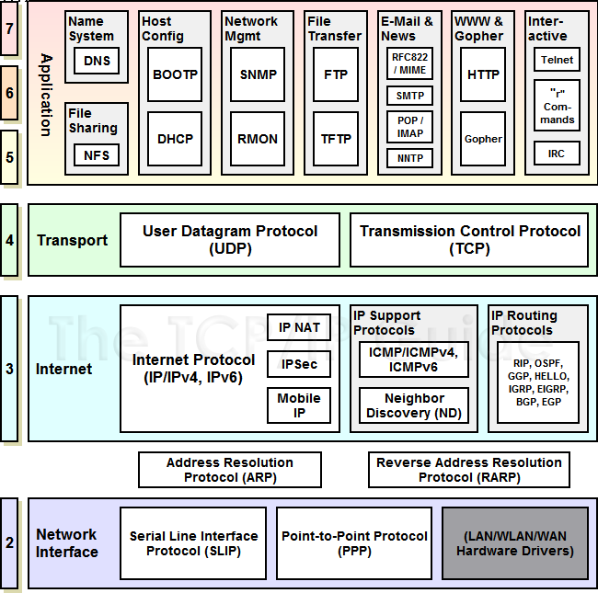
Data Communications for a Global Environment
Other Protocols associated with the TCP/IP stack

Slide 5
Introduction - Transport layer
Data Communications for a Global Environment
Application Layer
Transport Layer
Network Layer
Multiplexing and Demultiplexing: transport layer protocols on a sending device multiplex the data received from many application programs for transport, combining them into a single stream of data to be sent.
Segmentation, Packaging and Reassembly: The transport layer segments the large
amounts of data it sends over the network into smaller pieces on the source machine, and
then reassemble them on the destination machine.
Connection Establishment, Management and Termination: Transport layer
connection-oriented protocols are responsible for the series of communications required to
establish a connection, maintain it as data is sent over it, and then terminate the connection
when it is no longer required.

Slide 6
Introduction - Transport layer
Data Communications for a Global Environment
Application Layer
Transport Layer
Network Layer
Acknowledgments and Retransmissions: The transport layer is where many protocols
are implemented that guarantee reliable delivery of data. This is done using a variety of
techniques, most commonly the combination of acknowledgments and retransmission timers.
Flow Control: Transport layer protocols that offer reliable delivery also often implement
flow control features. These features allow one device in a communication to specify to
another that it must "throttle back" the rate at which it is sending data, to avoid bogging
down the receiver with data.

Slide 7
Data Communications for a Global Environment
Application Layer
Transport Layer
Identifying the Applications
- Software Applications are identified by the assignment of Port Numbers.
- The assignment of Port Numbers is managed by the Internet Assigned
Numbers Authority (IANA) and they periodically publish updated lists
of common TCP/IP applications and assigned well known and registered
Port numbers.
note: the server always uses the standardized port number while the client
uses ephemeral or (temporary) port numbers.
Network Layer

Slide 8
Data Communications for a Global Environment
TCP/IP Applications and common Port numbers
Port # TCP/UDP Protocol Abbreviation Application or Protocol Name
7 TCP/UDP n/a Echo Protocol
9 TCP/UDP n/a Discard Protocol
11 TCP/UDP n/a Active Users Protocol
20 TCP FTP (data) File Transfer Protocol – data
21 TCP FTP (control) File Transfer Protocol – control
23 TCP n/a Telnet Protocol
25 TCP SMTP Simple Mail Transport Protocol
53 TCP/UDP DNS Domain Name Server
80 TCP HTTP Hypertext Transfer Protocol
110 TCP POP3 Post Office Protocol
143 TCP IMAP Internet Access Message Protocol
161 UDP SNMP Simple Network Management Protocol
443 TCP HTTP over SSL Hypertext Transfer Protocol over
Secure Sockets Layer

Slide 9
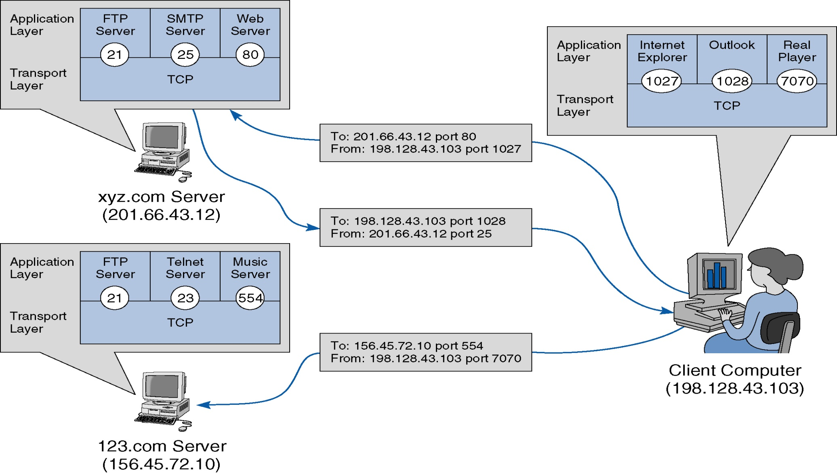
Application Layer Services
Data Communications for a Global Environment

Slide 10
Introduction - Transport layer
Data Communications for a Global Environment
Application Layer
Transport Layer
Network Layer
TCP Characteristics
Connection-Oriented: TCP requires that devices first establish a connection with each other before they send data. The connection creates the equivalent of a circuit between the units, and is analogous to a telephone call. A process of negotiation occurs to establish the connection, ensuring that both devices agree on how data is to be exchanged.
Bidrectional: Once a connection is established, TCP devices send data bidirectionally. Both devices on the connection can send and receive, regardless of which of them initiated the connection.
Multiply-Connected and Endpoint-Identified: TCP connections are identified by the pair of sockets used by the two devices in the connection. This allows each device to have multiple connections opened, either to the same IP device or different IP devices, and to handle each connection independently without conflicts.

Slide 11
Introduction - Transport layer
Data Communications for a Global Environment
Application Layer
Transport Layer
Network Layer
TCP Characteristics (cont’d)
Reliable: Communication using TCP is said to be reliable because TCP keeps track of data that has been sent and received to ensure it all gets to its destination. As we saw in the previous topic, TCP can't really “guarantee” that data will always be received. However, it can guarantee that all data sent will be checked for reception, and checked for data integrity, and then retransmitted when needed. So, while IP uses “best effort” transmissions, you could say TCP tries harder, as the old rent-a-car commercial goes.
Acknowledged: A key to providing reliability is that all transmissions in TCP are acknowledged (at the TCP layer—TCP cannot guarantee that all such transmissions are received by the remote application ). The recipient must tell the sender “yes, I got that” for each piece of data transferred. This is in stark contrast to typical messaging protocols where the sender never knows what happened to its transmission. As we will see, this is fundamental to the operation of TCP as a whole.

Slide 12
Introduction - Transport layer
Data Communications for a Global Environment
Application Layer
Transport Layer
Network Layer
TCP Characteristics (cont’d)
Stream-Oriented: Most lower-layer protocols are designed so that to use them, higher-layer protocols must send them data in blocks. IP is the best example of this; you send it a message to be formatted and it puts that message into a datagram. UDP is the same. In contrast, TCP allows applications to send it a continuous stream of data for transmission. Applications don't need to worry about making this into chunks for transmission; TCP does it.
Data-Unstructured: An important consequence of TCP's stream orientation is that there are no natural divisions between data elements in the application's data stream. When multiple messages are sent over TCP, applications must provide a way of differentiating one message (data element, record, etc.) from the next.
Data-Flow-Managed: TCP does more than just package data and send it as fast as possible. A TCP connection is managed to ensure that data flows evenly and smoothly, with means included to deal with problems that arise along the way.

Slide 13
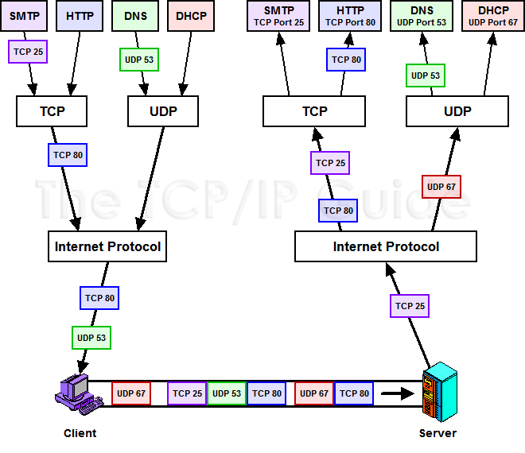
TCP/IP multiplexing using TCP/UDP ports
Data Communications for a Global Environment

Slide 14
Introduction - Transport layer
Data Communications for a Global Environment
Application Layer
Transport Layer
Network Layer
Establishing the connection to a remote Host
Connection Oriented is provided by TCP
Setting up a virtual circuit, or a TCP connection
TCP asks IP to route all packets in a message by using the same path (from source to destination)
Packet deliveries are acknowledged
Used by HTTP, SMTP, FTP
This is also know as a reliable protocol. With TCP the Transport layer can ensure that all pieces reach their destination by having the source device to retransmit any data that is lost.

Slide 15
Setting up Virtual Connections
Data Communications for a Global Environment
A
B
Requests a virtual circuit (TCP connection) and negotiates packet size with B
SYN
SYN
Data 1
Data 2
Sends data packets one by one (in order) using continuous ARQ (sliding window)
ACK 2
Data 3
Data 4
FIN
Closes virtual circuit
not busy

Slide 16
Introduction - Transport layer
Data Communications for a Global Environment
Application Layer
Transport Layer
Network Layer
Establishing the connection to a remote Host
Connectionless communication is provided by UDP
Sending packets individually without a virtual circuit
Each packet is sent independently of one another, and will be routed separately, following different routes and arriving at different times

Slide 17
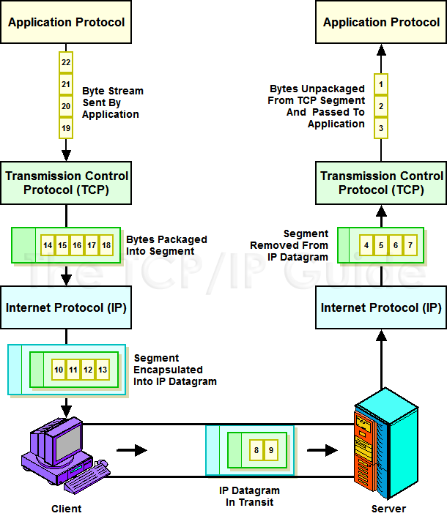
TCP/IP a more realistic model
Data Communications for a Global Environment

Slide 18
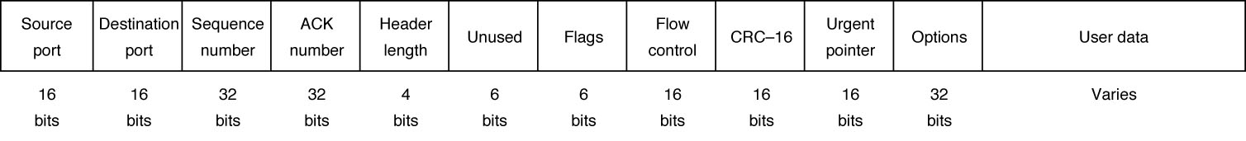
TCP Message Header
Data Communications for a Global Environment
3 most significant pieces of information
used in message reassembly
TCP Header: 192 bits (24 bytes)

Slide 19
Routing Connectivity by Transport Layer
Connection Oriented is provided by TCP
Setting up a virtual circuit, or a TCP connection
TCP asks IP to route all packets in a message by using the same path (from source to destination)
Packet deliveries are acknowledged
Used by HTTP, SMTP, FTP
Connectionless Routing is provided by UDP
Sending packets individually without a virtual circuit
Each packet is sent independently of one another, and will be routed separately, following different routes and arriving at different times
QoS Routing (provided by RTP)
A special kind connection oriented routing with priorities

Slide 20
UDP - User Datagram Protocol
Data Communications for a Global Environment
Protocol used for connectionless routing in TCP/IP suite that uses no acks, no flow control
Uses only a small packet header
Only 8 bytes containing only 4 fields:
Source port
Destination port
Message length
Header checksum
Commonly used for control messages that are usually small, such as DNS, DHCP, RIP and SNMP.
Can also be used for applications where a packet can be lost, such as information rich video

Slide 21
QoS - Quality of Service
Data Communications for a Global Environment
QoS parameters - Bandwidth, End to End delay, Jitter and Packet Loss.
Bandwidth – is the avg numbers of bits per second that travel successfully through the network measured in Kbps or Mbps.
End to End delay – is the avg time it takes for a network packet to traverse the network from one endpoint to another.
Jitter - is the variation in E to E delay of sequential packets
Packet Loss - % of transmitted packets that never reach the
the destination.

Slide 22
QoS - Quality of Service
Data Communications for a Global Environment
The three fundamental QoS enablers are:
Network Provisioning – providing more bandwidth than required.
Queuing – pertains to transmission buffers in network switches and routers.
Classifying – is a packet classifying or prioritization scheme
- Resource Reservation (RSVP)
- IP Precedence, Differentiated Services (DiffServ)
- Multiple Protocol Label Switching (MLPS)

Slide 23
Protocols Supporting QoS
Data Communications for a Global Environment
Asynchronous Transfer Mode (ATM)
A high-speed data link layer protocol
TCP/IP protocol suite
Resource Reservation Protocol (RSVP)
Sets up virtual circuits for general purpose real-time applications
Real-Time Streaming Protocol (RTSP)
Sets up virtual circuits for audio-video applications
Real-Time Transport Protocol (RTP)
Used after a virtual connection setup by RSVP or RTSP
Adds a sequence number and a timestamp for helping applications to synchronize delivery
Uses UDP (because of its small header) as transport
RSVP
RTSP
RTP
UDP
IP

